Slide 1

Smart Gate
Batch No: A-04 Project Guide:
R.Hemalatha (164G1A0530) Dr.T.Hithendra sarma, MTech., Ph.D.
K.Likith kumar (164G1A0549) Principal
K.Keerthi Reddy (164G1A0537)
A.Ganesh (164G1A0526)
Srinivasa Ramanujan Institute of Technology
Department of Computer Science & Engineering

Slide 2
Abstract:
Smart Gate Technology is based on Embedded systems and Deep Learning. It involves face recognition and raspberry pi. Smart gate is used to allow only valid persons.

Slide 3
Literature survey:
OpenCV tutorials point
Raspberry pi tutorials point
https://www.researchgate.net/publication/220566092_Face_Recognition_A_Literature_Survey
https://pythonhosted.org/facereclib/references.html

Slide 4
Existing System:
Normal gate:
It opens the gate without any authorization
Automatic gate:
Just as sensor without validation
Limitations:
No security
Time Taking Process

Slide 5
Proposed System
Raspberry pi with validation check
Checks the image with existing dataset
If it is exist then it opens the gate otherwise it does not open the gate
Scope of our project:
It is a supervised learning.
Only one person should stand Infront of the camera

Slide 6
Face recognition:
A facial recognition system is a technology capable of identifying or verifying a person from a digital image as a source. There are multiple methods in which facial recognition systems work, but in general, they work by comparing selected facial features from given image with faces within a database.

Slide 7
Cntd…
Face recognition is used to check that a person has permission to enter the organization or not. The output of facial recognition in raspberry pi is going to send power supply to stepper motor then it turns to 90 degrees that means door will open otherwise it gives sound by bursar.

Slide 8
Requirements:
Hardware Requirements:
RAM : 4GB
Processor : intel core i3
Raspberry pi model 3
USB camera
Stepper motor
32 GB memory card
Software requirements:
Raspberry pi OS
Python IDE
OpenCV

Slide 9
Planning:
Task | Date
Requirements (Abstract review) | 20-12-2019
Analysis (Problem Definition , Planning , Literature survey) | 25-01-2019
Design and Implementation (coding) | 01-03-2020
Testing | 15-03-2020
Output of project(Result) | 20-03-202
Maintenance and (Deployment) | Never end process
Document submission | 06-04-2020

Slide 10
Installation of Raspbian stretch and OpenCV
By using below link install Raspbian stretch with OpenCV on memory card
https://www.pyimagesearch.com/2017/09/04/raspbian-stretch-install-opencv-3-python-on-your-raspberry-pi/

Slide 11
Open CV
OpenCV (Open source computer vision) is a library of programming functions mainly aimed at real-time computer vision.
Computer vision is a field of study which encompasses on how computer see and understand digital images and videos.

Slide 12
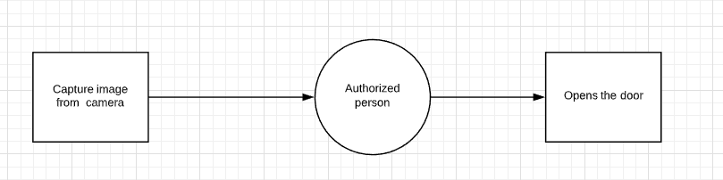
Data Flow Diagram:
Level-0:

Slide 13
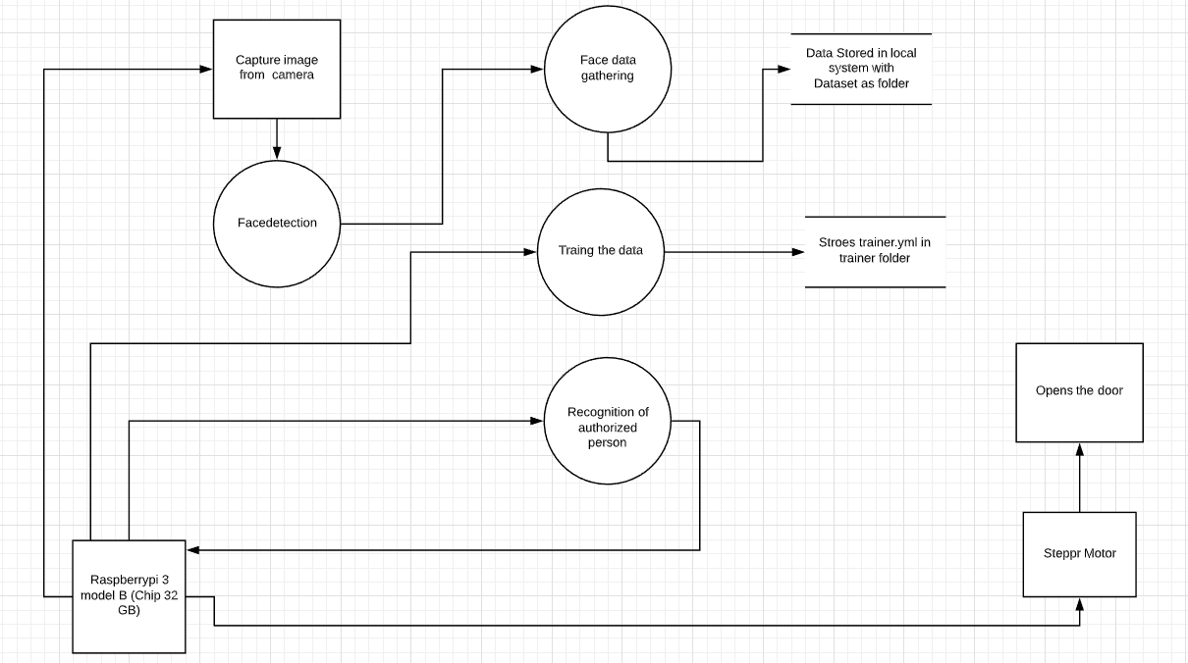
Level 1:

Slide 14
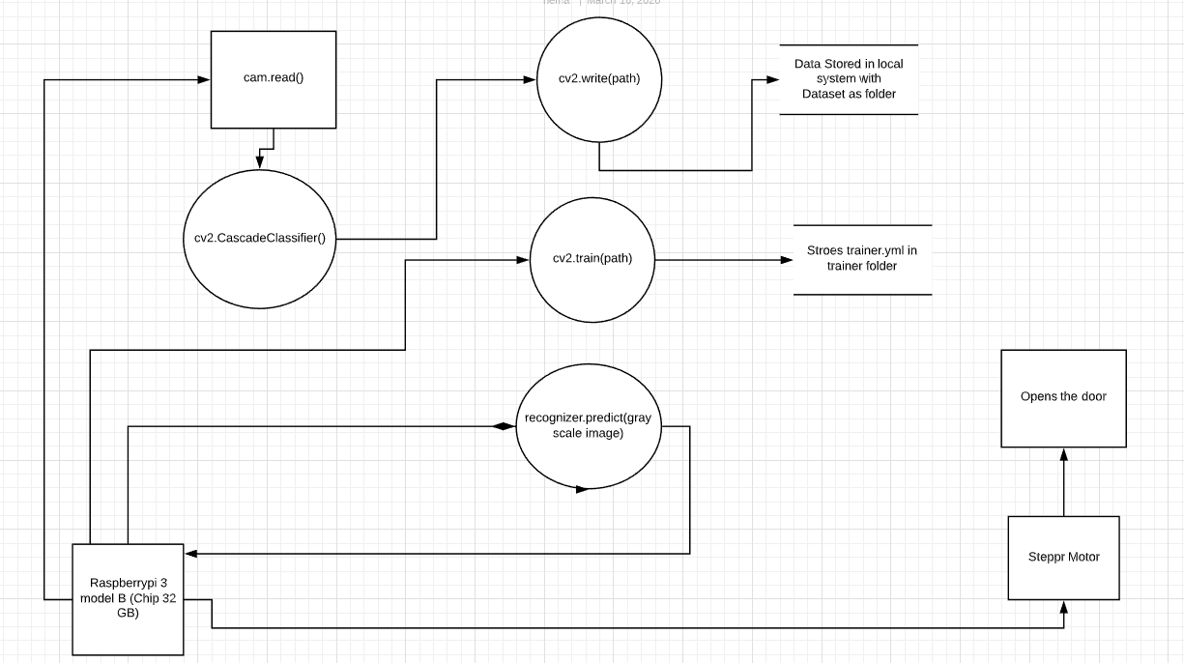
Level 2:

Slide 15
Face Detection
we need to import the cv2 module, which will make available the functionalities needed to read the original image and to convert it to gray scale.
import cv2
Syntax for xml file:
faceCascade = cv2.CascadeClassifier('Cascades/haarcascade_frontalface_default.xml')

Slide 16
Cntd...
Face detection is a computer technology being used in a variety of applications that identifies human faces in digital images.
The most common way to detect a face by using the Haar Cascade classifier.
Haar Cascade is a machine learning object detection algorithm used to identify objects in an image or video(LBPH).

Slide 17
Cntd...
To read the original image, We call the imread function of the cv2 module, passing as input the path to the image, as a string.
Image=cv2.imread(' C:\Users\R hemalatha/164G1A0530.jpg’)
To read the image through video,we call videocapture function.
cap = cv2.VideoCapture(0)

Slide 18
Image colour
To convert our original image from the BGR color space to gray, we use the code COLOR_BGR2GRAY.
gray=cv2.cvtColor(image,cv2.COLOR_BGR2GRAY)

Slide 19
Detect Multi Scale:
we must call our classifier function, passing it some very important parameters, as scale factor, number of neighbors and minimum size of the detected face.
faces = faceCascade.detectMultiScale(
gray,
scaleFactor=1.2,
minNeighbors=5,
minSize=(20, 20)
)
where facecascade is the xml file,
gray is the input grayscale image

Slide 20
Cntd...
scaleFactor is the parameter specifying how much the image size is reduced at each image scale. It is used to create the scale pyramid.
minNeighbors is a parameter specifying how many neighbors each candidate rectangle should have, to retain it. A higher number gives lower false positives.
minSize is the minimum rectangle size to be considered a face.

Slide 21
Image Shape
To mark the faces in the image, using, for example, a blue rectangle.
cv2.rectangle(img,(x,y),(x+w,y+h),(255,0,0),2)
roi_gray = gray[y:y+h, x:x+w]
roi_color = img[y:y+h, x:x+w]
(x,y)
hight
width

Slide 22
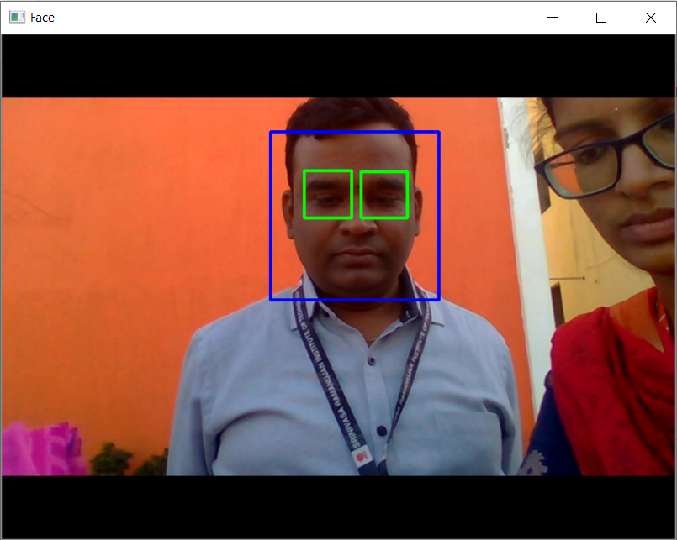
Output face with eye capture

Slide 23
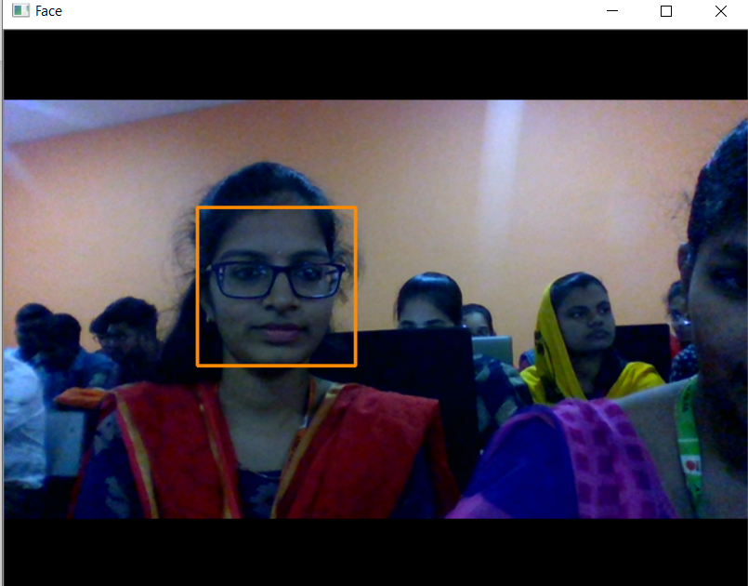
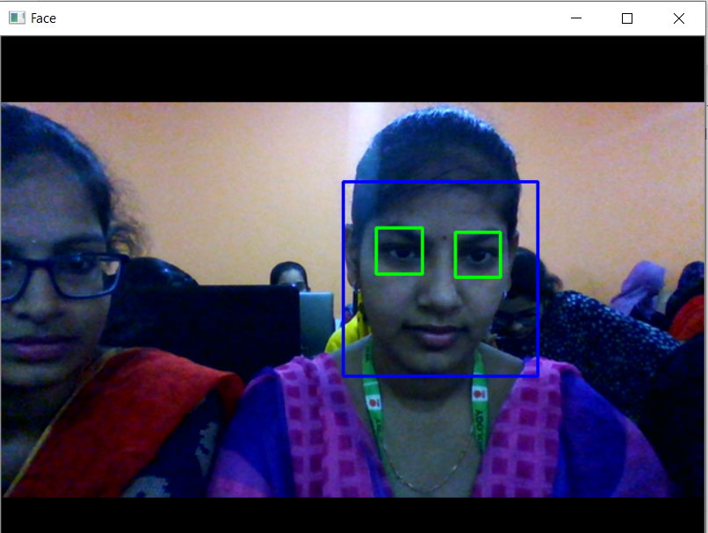
Outputs of :
Face detect
Face and eyes detection

Slide 24
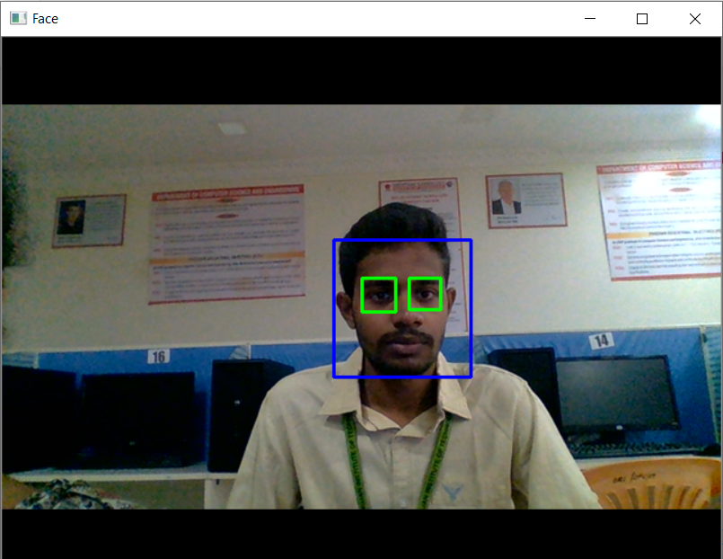
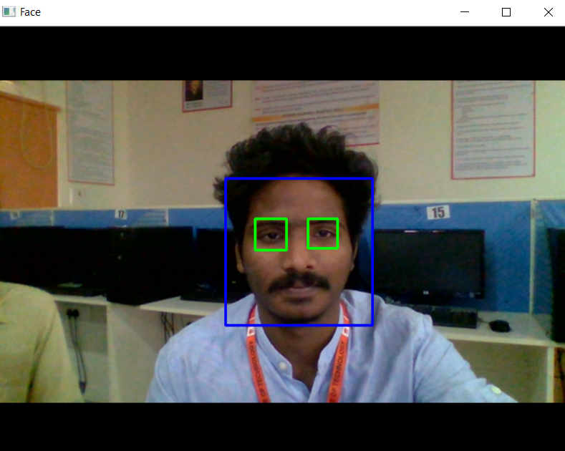
Cntd..

Slide 25
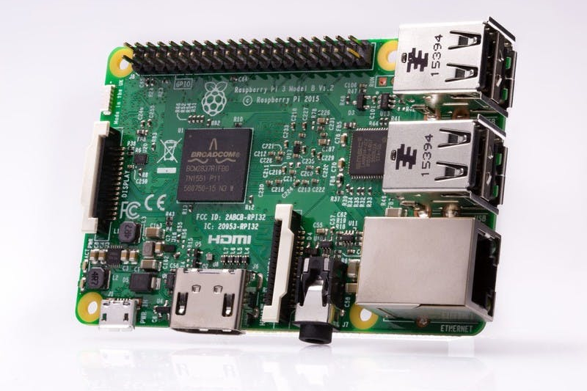
Raspberyy pi 3 Model B :

Slide 26
Specifications :
Full size HDMI
1GB RAM
40-pin extended GPIO
4 USB 2 ports
Micro SD port for loading your operating system and storing data
Upgraded switched Micro USB power source up to 2.5A

Slide 27
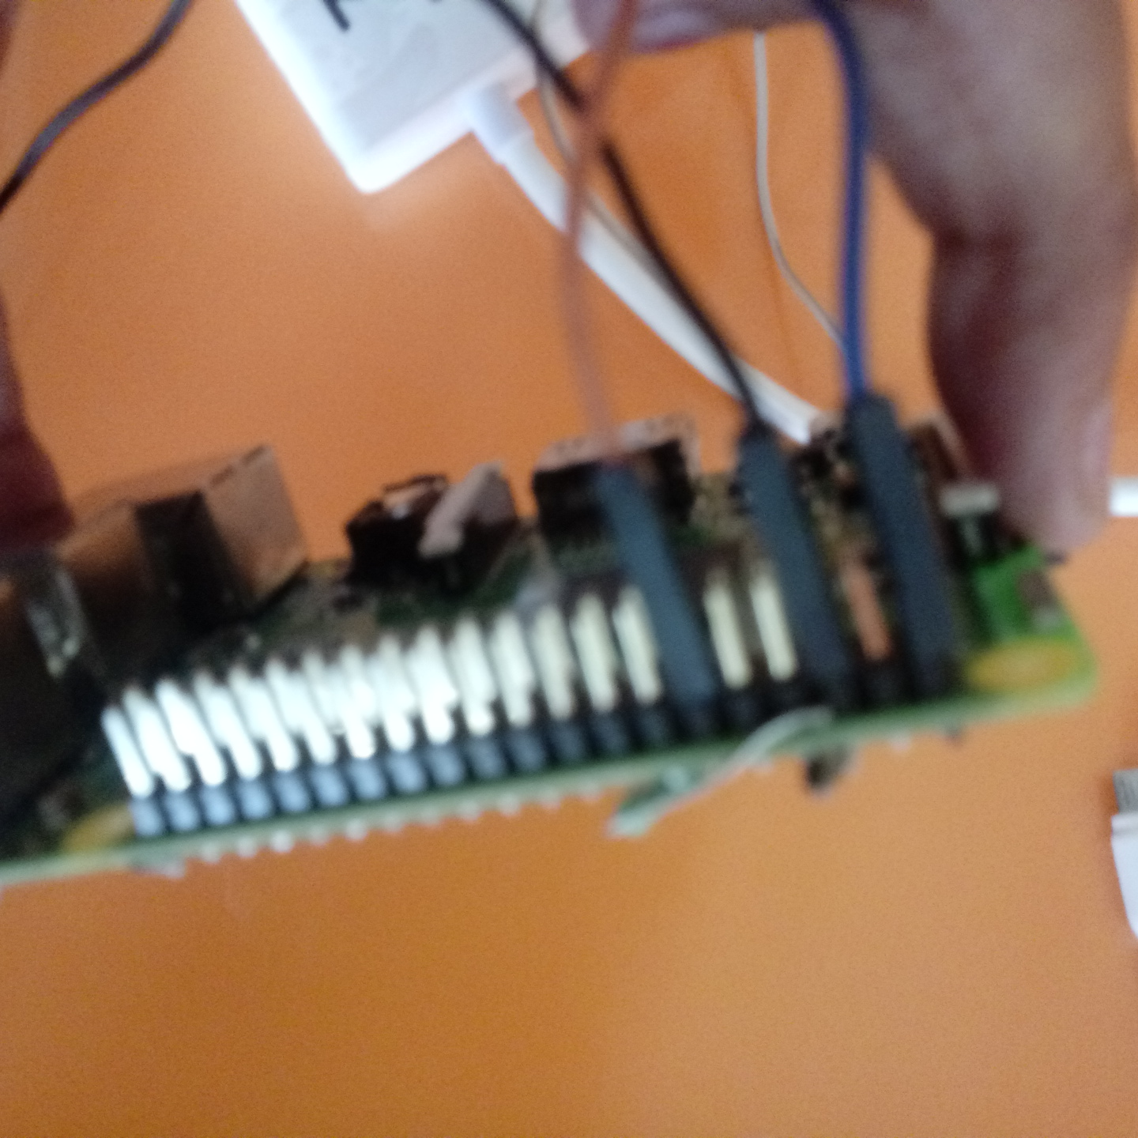
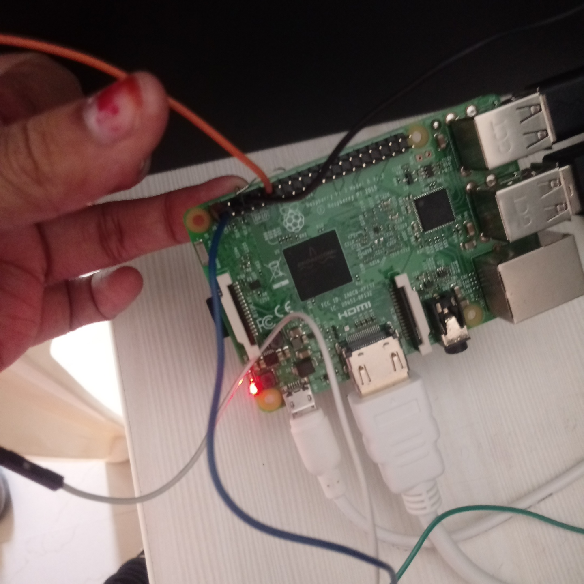

Slide 28
Data gathering:
For each person, enter one numeric face id
face_id = input('\n enter user id end press <return> ==> ')
Save the captured image into the datasets folder
cv2.imwrite("dataset/User." + str(face_id) + '.' + str(count) + ".jpg", gray[y:y+h,x:x+w])
Take 50 samples and quit

Slide 29
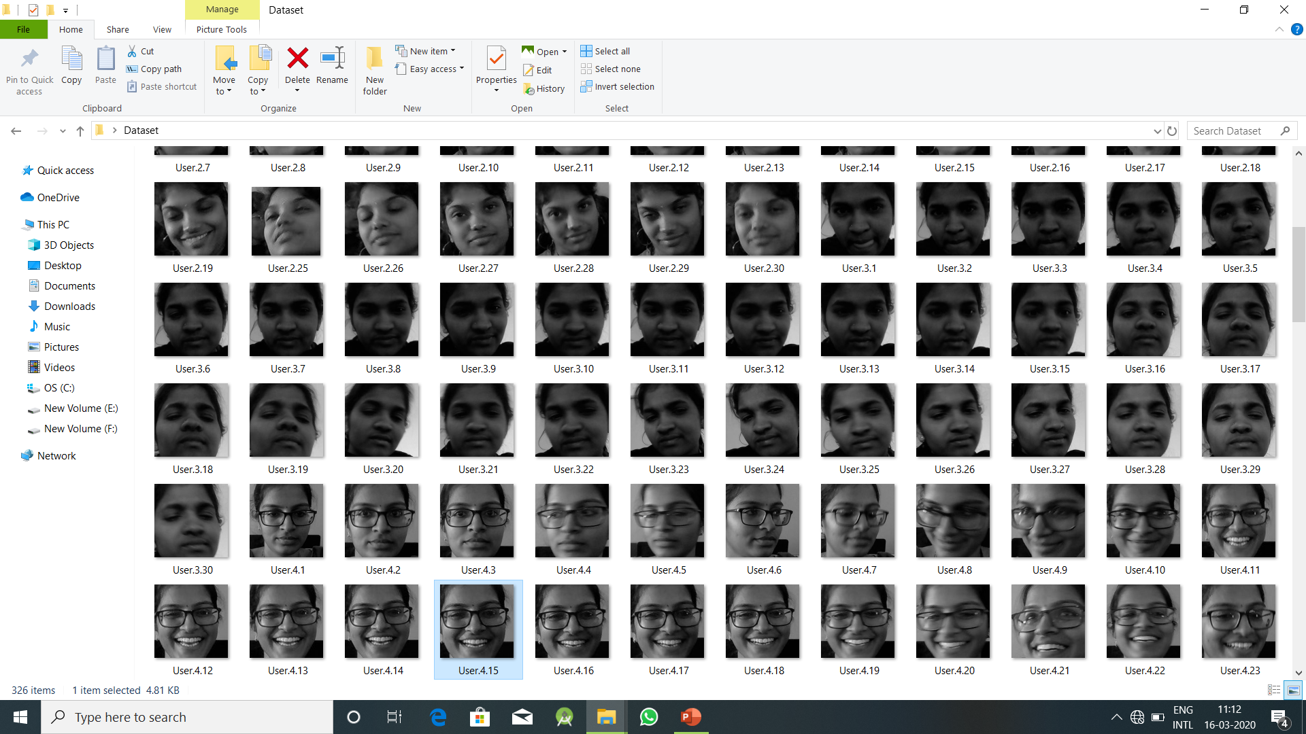
Dataset:

Slide 30
Training the data:
Path for face image database
path = 'dataset’
Using LBPH algorithm
recognizer = cv2.face.LBPHFaceRecognizer_create()
Training the dataset
recognizer.train(faces, np.array(ids))
Save the model into trainer/trainer.yml
recognizer.write('trainer/trainer.yml')

Slide 31
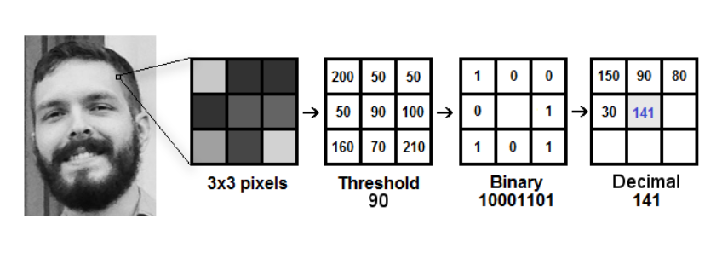
LBP:
Local Binary Pattern (LBP) is a simple yet very efficient texture operator which labels the pixels of an image by thresholding the neighborhood of each pixel and considers the result as a binary number.

Slide 32
Recognition of valid person:
Raspberry pi interacts with GPIO pins
import RPi.GPIO as GPIO
In GPIO.setup() has two parameters in that 12 pin represents the output pin of pi will interact with GPIO to show the output
GPIO.setup(12, GPIO.OUT)
PWM (pulse with modulation) is a technique for controlling power. We use it here to control the amount of power going to the motor and hence how fast it spins.
p = GPIO.PWM(12, 50)

Slide 33
Cntd…
The recognizer.predict (), will take as a parameter a capture portion of the face to be analyzed and will return its probable owner, indicating its id and how much confidence the recognize is in relation with this match. Recognize the face belongs to which ID
id = recognizer.predict(gray[y:y+h,x:x+w])
If Id matches the existing data set then it turns to 90 degrees by using
p.changeDutyCycle(7.5)

Slide 34
References:
https://opencv-python-tutroals.readthedocs.io/en/latest/py_tutorials/py_objdetect/py_face_detection/py_face_detection.html#face_detection
https://www.superdatascience.com/blogs/opencv-face-detection
https://www.instructables.com/id/real-time-face%20-recognition-an-end-to-end-project/

Slide 35
THANK YOU
Queries
?

